Slide 1
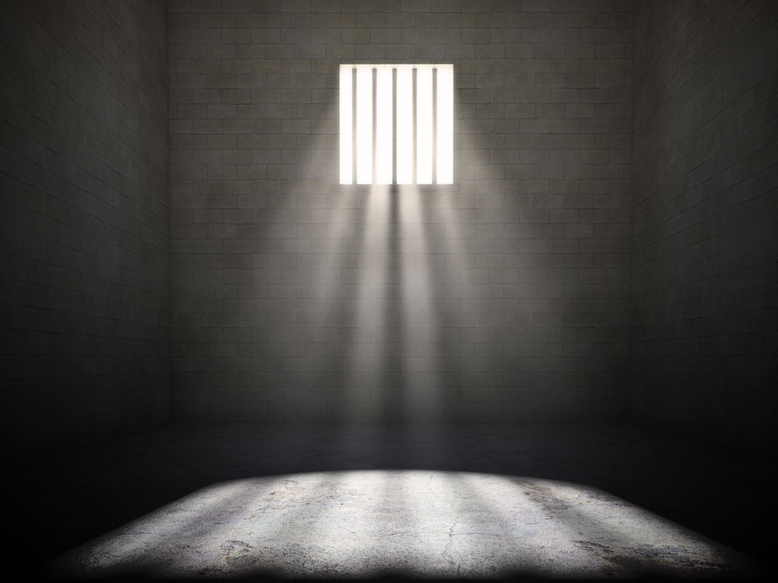
Using the RTI ACT for protecting the rights of prisoners
MRINAL SHARMA

Slide 2
WHAT WE DO?
Prevent Unnecessary Detention
Prison Monitoring and Administration

Slide 3
WHAT WE DO?
MONITOR PRISONS
prioritize the proper functioning of prison oversight mechanisms
MONITOR COURT PRACTICES
assess the pre-trial practices of court
ENSURE EFFECTIVE REPRESENTATION
advocate for early access to counsel and improve legal aid practices
URGENT ACTION
work with governments for early repatriation of foreign national prisoners
LEGAL CLINICS
partner with law schools to develop legal aid clinics that provide free legal support to prisoners
URGENT ACTION
ensure timely release and rehabilitation of vulnerable groups in prison

Slide 4
OUR METHOD
Research
Advocacy
Capacity Building
Strategic Litigation

Slide 5
Research
LEGAL AID CLINICS
RIGHT TO INFORMATION

Slide 6
6
4
SUCCESSES
Operational Undertrial Review Committees due to watch reports
Regular Appointments of Prison Visitors due to evidence based advocacy
Foreign Prisoners Overstaying their Sentence
Diet and Medical Facilities in Haryana and J&K
Successful Strategic Litigation due to exemplary data collection
Formal Guidelines on Repatriation due to Pressure-Building
Compliance Study on all States’ Prison Websites
Instrumental in changing the face of disclosure in West Bengal

Slide 7
CHALLENGES
LANGUAGE BARRIER IN A DIVERSE NATION
INFORMATION MANAGEMENT
NO STANDARD FORMAT FOR WRITING APPLICATION
UNCERTAINITY REGARDING THE KEEPER OF INFORMATION
CONFRONTATION IN AN OTHERWISE HAND HOLDING RELATIONSHIP
INCESSANT AND UNNECESSARY FORWARDING
VAGUE RESPONSES
LACK OF/NOT UPDATED INFORMATION ON INFORMATION OFFICERS

Slide 8
HOW DO WE USE RTI?
PRISON
POLICE
COURTS
LEGAL SERVICES
CENTRAL GOVERNMENT
STATE GOVERNMENT

Slide 9
HOW THE SYSTEM RESPONDS
RESPONSIVE
LEGAL SERVICES
POLICE
COURTS
PRISON
GOVERNMENT
NON RESPONSIVE

Slide 10
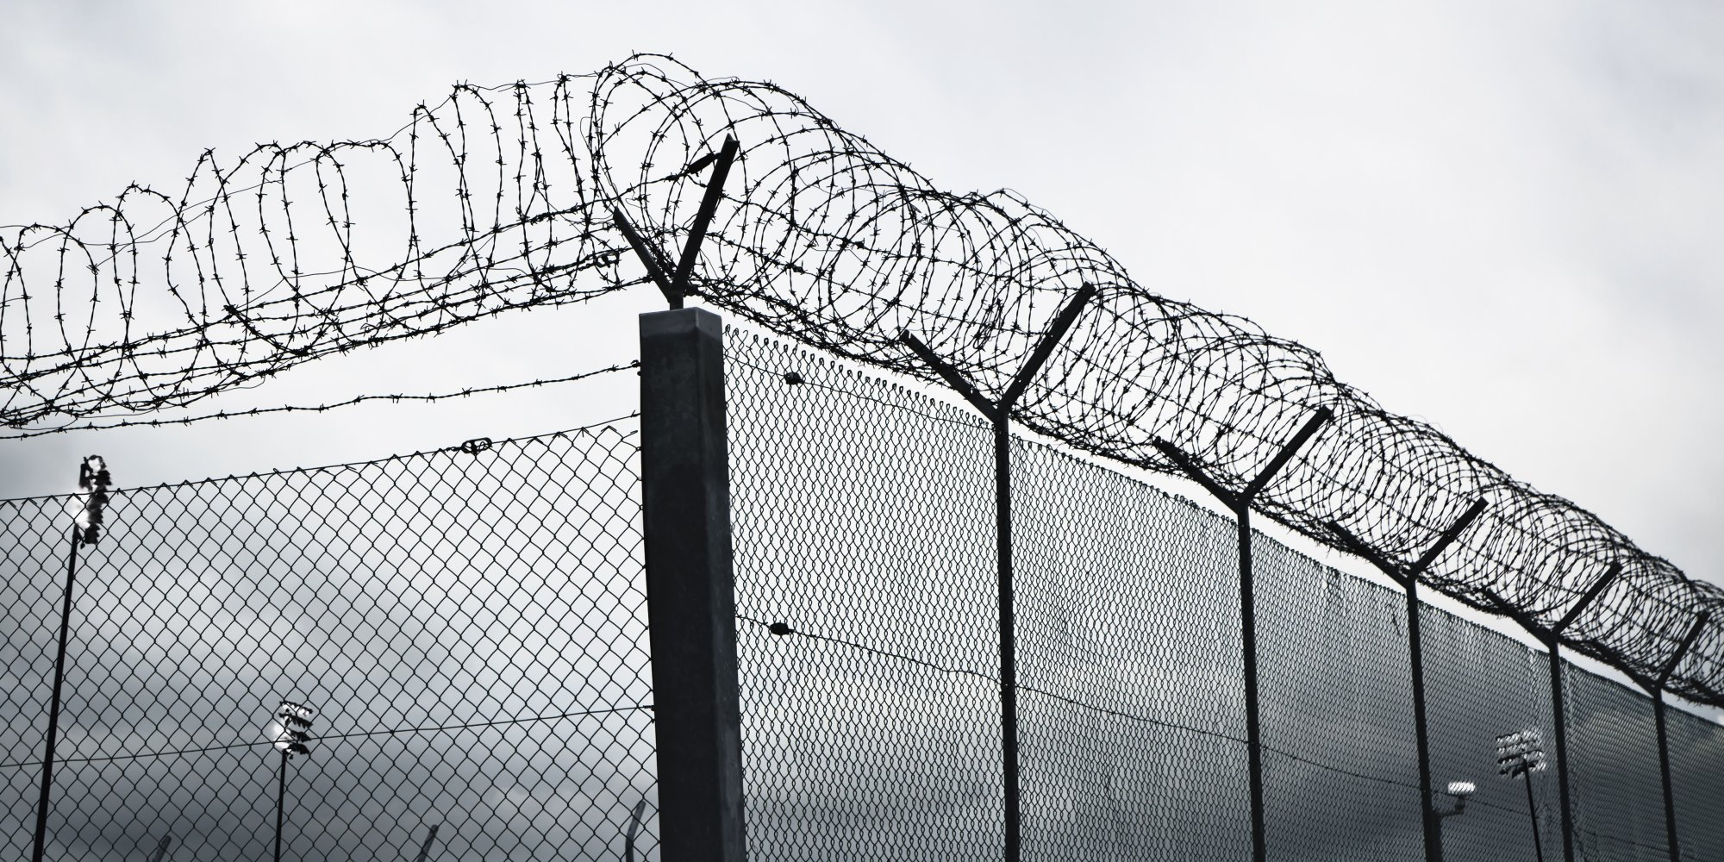
PRISON
PRISON MONITORING
National and State Wise assessment of Prison Monitoring Mechanisms like Undertrial Review Committees and Board of Visitors
FAIR TRIAL
State based inquiry into physical production of accused in the Courts during their trial
GROUPS WITH SPECIAL NEEDS
Facilities provided to communities with special needs like mentally ill and foreign national prisoners, asylum seekers and juveniles
COMPLIANCE TO COURT ORDERS
National and State-wise compliance of judgments passed on prison reform
State based information on deaths in judicial custody and corresponding documentation; parole and pre-mature release

Slide 11
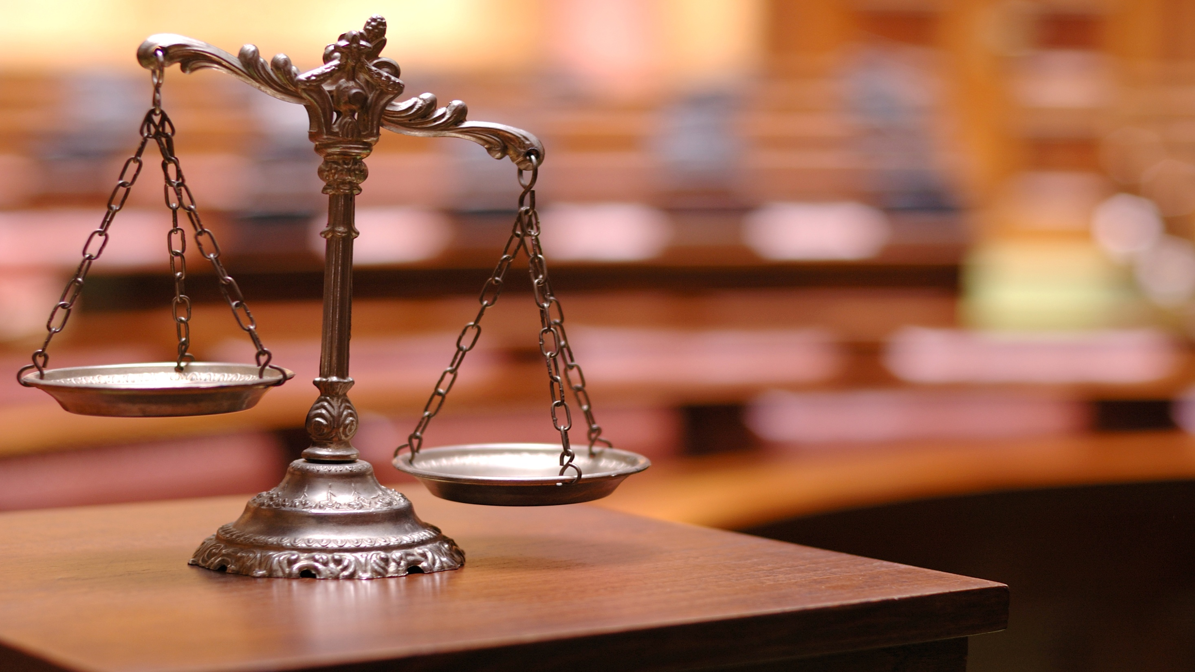
LEGAL SERVICES
To collect evidence on the functioning of various central and state sponsored legal aid schemes, we have made state specific inquiries into the complete functioning of 3 Legal Aid schemes and the running of legal aid camps; national inquiry into duty Counsel Schemes in Police Stations, Courts & Prisons and year wise details of legal aid beneficiaries.

Slide 12
POLICE
While understanding the lack of deployment of police escorts and sentries to take the prisoner from the prison to the court and back, we made inquiries with the police for the governing standards. We also made inquiries to the Police Headquarters in one of the states to obtain statistics on preventive detention.

Slide 13
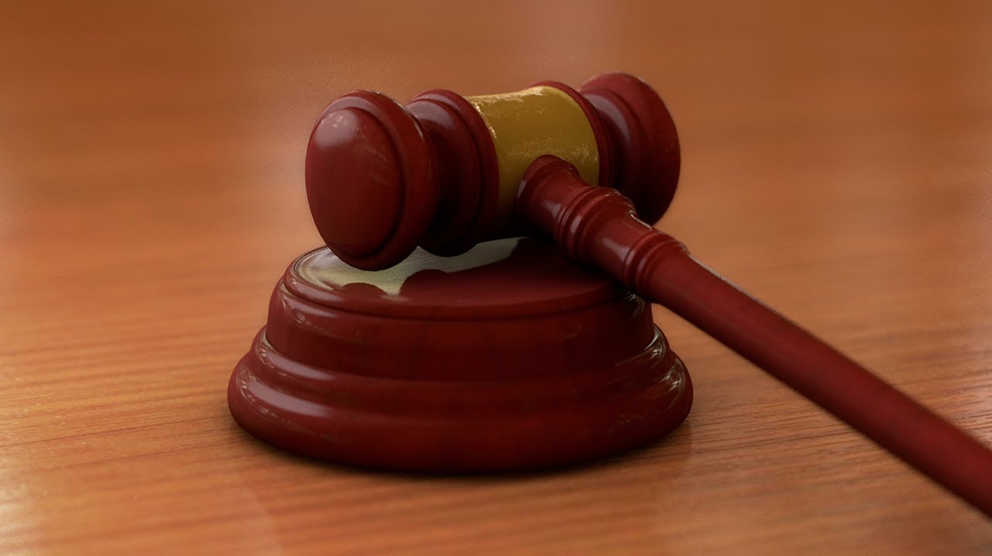
COURT
We mostly make inquiries to monitor and study the compliance of court’s earlier orders on legal aid, vulnerable groups, judicial oversight and implementation of already existing safeguards.

Slide 14
GOVERNMENT
Depending on the mandate, inquiries are made on status of appointment and recruitment of visitors to prison and prison officials. In the past, inquiries have also been made to understand the implementation of specific legal aid projects launched by Ministry of Justice. We often seek information from the Ministry of Home Affairs on standards, reports and comments provided to them or by them in areas related to foreign prisoners in Indian Jails. In one instance, we had sought the number of mental hospitals in India from the Ministry of Health for our preliminary research on mentally ill prisoners.

Slide 15
QUESTIONS?

